Slide 1
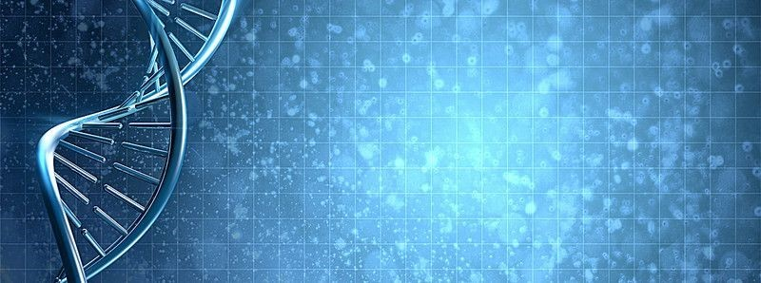
Exploration and Analysis of Gene-Disease Associations
ARUN AGARWAL
Temple university
Data science

Slide 2

About Me
University: Temple
Junior
Major: Data Science with a Concentration in Computational Analytics
Minor: Mathematics
Working under Dr. Arjun Krishnan and Anna Yannakopoulos
Notes:
Temple University, Junior
Major and Minor
In the ACRES REU, I have worked under Arjun and Anna for a project that aims to analyze correlations between distinct experimental methods for gene-disease relationships.

Slide 3
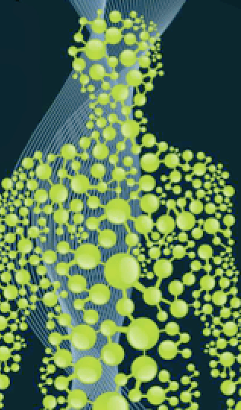
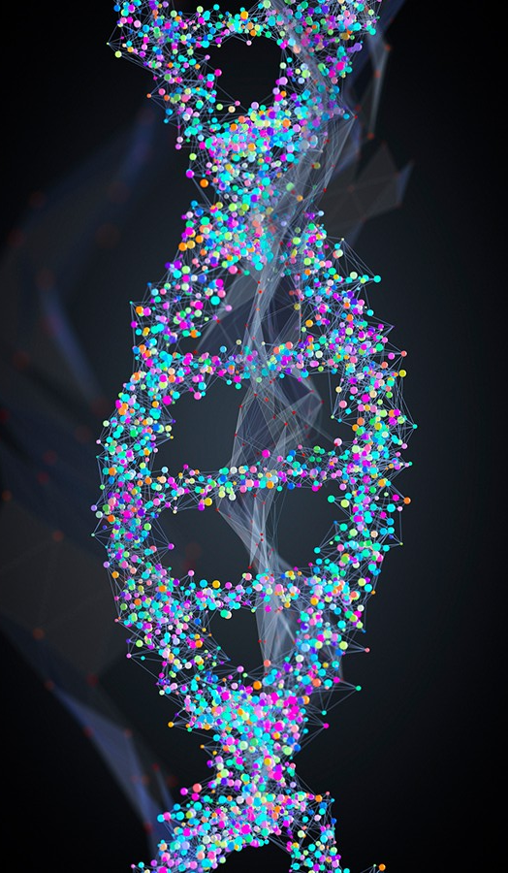
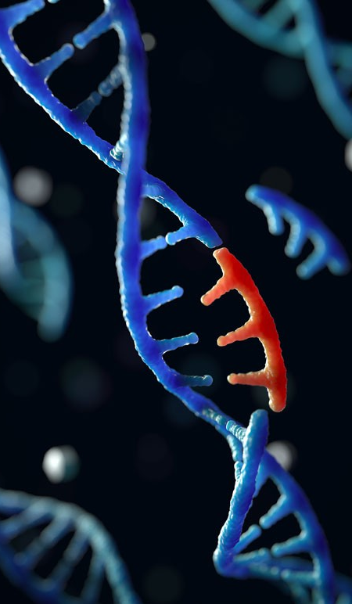
INTRODUCTION/MOTIVATION
X
X
= Gene
= Disease
= Gene
= Disease
= Gene
= Disease
= Experimental Method
Notes:
CLICK
The many trillions of cells in the human body are each sustained by the activities of thousands of genes in the genome. Here, I have drawn out some diseases, represented by circles, and their associated genes, represented by triangles, connected by lines, to show their relationship. Genetic mutations prevent one or more of these genes from working properly; when such a mutation alters a gene that plays a critical role in the body, it can disrupt normal development and cause a medical condition.
CLICK
To work towards cures for such complex diseases, we study the human genome, leading to the discovery of new gene-disease associations, of old gene-disease associations being debunked, and of genes being correlated to multiple diseases, creating a network.
CLICK
However, this has been studied through various experimental methods, each of which has provided a different and sometimes unique understanding of the disease’s underlying genetic cause. As shown on the right with the squares (representing different experimental methods), genes for a disease can be labeled under one association type but not another, yet they are all mapped to the same disease.

Slide 4
GOALS
Hypothesis: The genomic basis of complex diseases can be understood on a holistic level through the exploration and combination of genetic data from many sources, experiments, and association types
Develop supervised machine learning approaches
Ensemble Model
Why Care:
Better understanding of complex diseases
Development of drugs to combat disease-related signals
X
= Gene
= Disease
= Experimental Method
Notes:
We then hypothesize that the genomic basis of complex diseases can be understood on a holistic level through the exploration and combination of genetic data from many distinct experimental methods.
We want to see if we can develop supervised machine learning approaches to determine if, for a given disease, genes from an association type can be used to accurately predict genes from another type based on their patterns of interaction in a gene network. From there, it is hoped we can combine the machine learning models from the different association types into an ensemble model that discovers novel genes across the human genome associated with that disease.
Such results can lead to a better understanding of the genomic basis of complex diseases and in the design of drugs that target and reverse the disease-related signals.

Slide 5
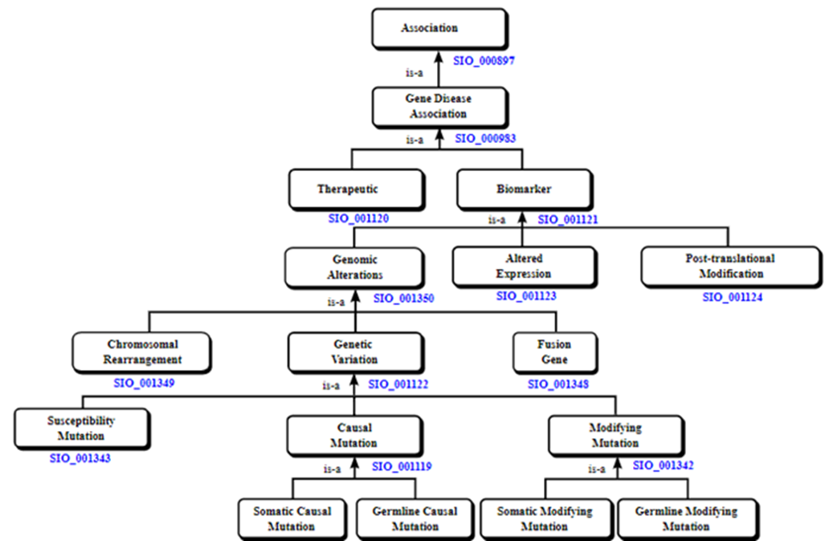
THE DATASET
DisGeNET database: collection of human gene-disease relationships
Maps 30,000+ diseases to 20,000+ genes
Database contains multiple files that we make use of
Uses an association type hierarchy (right)
Notes:
For this project, a source we found to be great for exploring these gene-disease associations was the DisGeNET database, a discovery platform that has one of the largest publicly available collection of genes and variants associated to human diseases to map over 30,000 human diseases to 20,000+ genes. While the datasets contain a lot of useful information, we focus our attention on three key columns, the disease ID, the gene ID, and the association type (which are pictured in a hierarchy here). I was told to think of these fifteen association types as different experiment types. As an example, Biomarker would be one of the most general or encompassing association type because it is at the top of the hierarchy.

Slide 6

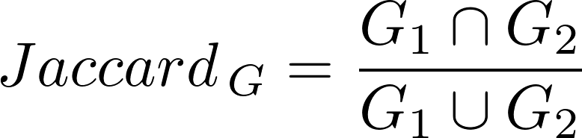
QUESTION RAISED
Do different experimental methods provide the same view of the underlying biology (lots of gene overlap between association types), or do they present different aspects of it (very separate gene sets)?
Notes:
After some preliminary data exploration, we basically tried to answer if the gene sets for the same disease, yet different association types, correlate or not. We measured the correlation of gene sets between association types for every disease using a Jaccard Index, which are grouped together to create a set of jaccard indices for each association type combination. We then take the median of these jaccard score sets to be plotted in a heatmap format.

Slide 7
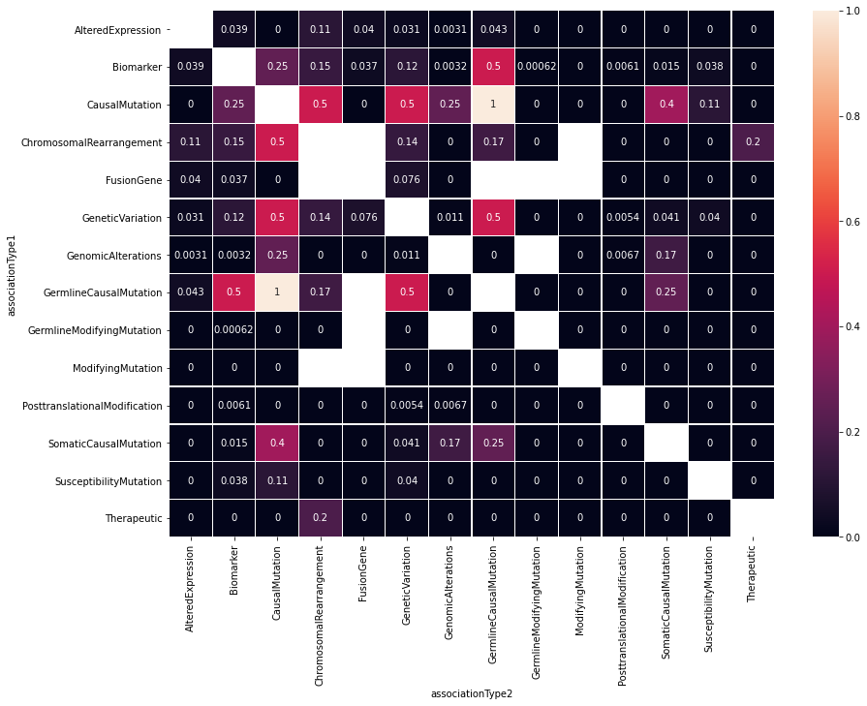
GENE EXPLORATION HEATMAP
Notes:
So here is the gene set comparison heatmap, where along both axes are all of the association types. We are trying to see which association types have the highest correlation between gene sets.
Although this heatmap can provide a lot of useful information, we don’t plan to use it further because we realized that it would be better to recategorize the dataset into five association types to create more succinct plots with equally valuable information.

Slide 8
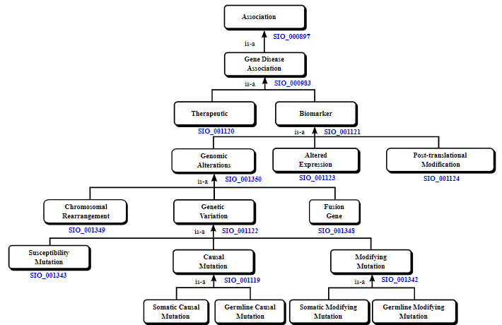
PROPAGATION AND RECATEGORIZATION
Notes:
Now, you may ask, how would we be able to sustain the data when we plan to remove ten of the fifteen association types from our dataset. We are able to do this through a process called propagation. By this, we mean that if a gene-disease pair is labeled as, for example, Genetic Variation, we will also label it as all of its ancestors (in this case, Genomic Alterations and Biomarker). This allows us to retain the unique and valuable data because our chosen recategorization includes the five association types at the top of the hierarchy…
CLICK
and all data that existed in the other ten association types will still be evident in the dataset through its propagated label.
I would like to note that I did this recategorization in two different ways, first with only using gene-disease pairs that are unique to biomarker (one of the association types), and then using all biomarker data. I will focus on the results of using all biomarker data.

Slide 9
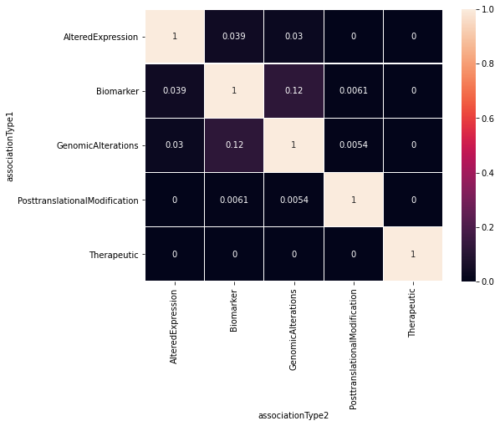
Heatmap of Median Jaccard Score for Association Pairs
Same Procedure as Prior:
How much gene overlap is there between association types for a disease?
Building gene sets for each disease
Compare Gene Sets from same disease but different association type
Jaccard Correlation Coefficient
Plot the scores in a boxplot and plot the median values of each association type combination in a heatmap
Notes:
Now, doing the same gene exploration procedure as we did with the whole dataset prior, we can get a heatmap for the propagated and recategorized dataset.
Overall, there are not high correlations whatsoever between association types, as can be seen by all the black squares, but I believe we were expecting these correlations to be low anyways because they are all pretty different from each other. Overall, what this means is that we confirmed our prediction that these different experimental methods do provide very unique views of the underlying biology.
The question then becomes, can we use supervised machine learning approaches to determine if, genes correlated to one association type can predict genes associated to another.
Even Genomic Alterations, Altered Expression, and Posttranslational Modification, which are children of Biomarker, have low correlations. The highest correlations, which are still low, are squared in red and can be seen between Biomarker/Altered Expression and Biomarker/Genomic Alterations, which we expect since we used all available Biomarker data from the original dataset here, which means if a gene-disease pair had labels of Altered Expression and Biomarker (for example), both get represented in the dataset.

Slide 10
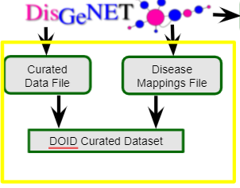
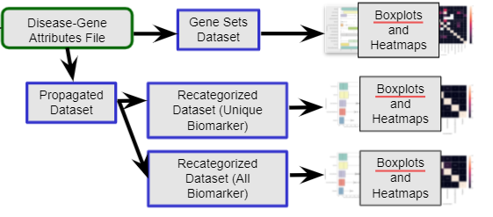
QUESTION RAISED
Based on the exploratory data analysis performed on the ‘DiseseGeneAttributes’ dataset, have we learned enough about the gene-disease associations to be able to use them in the next steps of the project?
Notes:
We learned that we needed to work with this dataset some more before continuing forward with it in the machine learning process. Since that would take some time, we thought we would set up the rest of the workflow by using a curated dataset, which compares sources instead of association types. This would also allow us to get a different sense of genes for a particular disease.
UNIPROT: database with curated info on protein sequence, structure and function. DisGeNET only included the human gene-disease associations marked as Disease from this database.
CTD/CTD_human (The Comparative Toxicogenomics Database): database with manually curated info about gene-disease relationships with focus on understanding how environmental exposures affect human health. DisGENET only included the associations marked as marker/mechanism or therapeutic.
ORPHANET: reference portal for info on rare diseases and orphan drugs to help improve the diagnosis, care, and treatment of patients with rare diseases. All gene-disease associations were kept by DisGeNET.
CLINGEN (Clinical Genome Resource): resource that defines the clinical relevance of genes and variants for use in precision medicine and research. DisGeNET uses all gene-disease associations exceptthose labeled as 'refuted.'
GENOMICS ENGLAND (Genomics England PanelApp): knowledge base that allows virtual gene panels related to human disorders to be created, stored, and queried. DisGeNET kept all gene-disease associations.
CGI (Cancer Genome Interpreter): tool that identifies known brain-tumor-causing alterations, predicts potential drivers among those of unknown significance, and itdentifies alterations in the tumor known to affect the response to anti-cancer drugs. It also has the catalog of Cancer Driver Genes, which is a selection of genes driving tumorigenesis (the formation/production of tumors) in a certain tumor type(s) upon a certain alteration. DisGeNET only kept validated data and not computational predictions.
PSYGENET (Psychiatric Disorders Gene Association Network): resource for exploratory analysis of psychiatric diseases and their associated diseases. DisGeNet uses all gene-disease associations from here.
Things to note:
Psygenet database used by DisGeNet is very small (both in gene count and disease count)! This leads to certain results with our machine learning model later on
CGI, PSYGENET, ORPHANET, and CTD_HUMAN are all pretty specific and distinct, so we can expect these to not be as correlated as CLINGEN and GENOMICS_ENGLAND, for example.

Slide 11
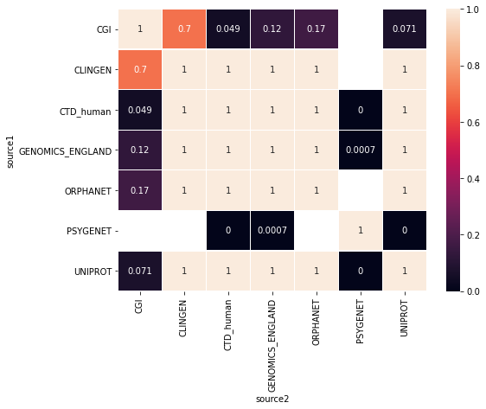
HEATMAP OF MEDIAN JACCARD COEFFICIENT VALUES BETWEEN SOURCES
Most Correlations are 1 → suggests small gene sets!
Would need to filter dataset
Blanks in heatmap are also not surprising!
Notes:
So, the heatmap would compare the median correlation between gene sets for sources. Based on all the perfect correlations between source pairs (represented by the tan squares with values of 1), we decided we should filter the data to meet conditions like a minimum gene set size for more workable data.
We also see some blanks in the heatmap between PSYGENET and other sources, which we can expect. There is only a very small amount of data from PSYGENET in this dataset, so it is very likely for us to see no possible correlations between that source and others. Especially since two of those sources, CGI and CLINGEN, are the next two smallest in size.

Slide 12
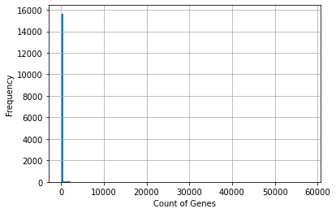
HISTOGRAM AND FILTERS
Filters:
Only kept diseases that were descendants of one of 14 higher-level diseases
Kept all the disease terms that have 10+ TOTAL genes (after propagation) from 3 different association types
Kept all the disease terms that have 5+ TOTAL direct gene annotations (without propagation)
Filtered out diseases that did not have at least 10 genes after propagation from EACH SOURCE for at least three sources
Notes:
To obtain this minimum size, we used histograms that visualized the amount of each gene set size. We can see that there was an overwhelmingly large number of diseases with small gene sets. So, the dataset was propagated, filtered using a disease ontology and chosen gene boundaries, and manually curated.
To obtain this minimum gene set size, we used histograms that visualized the amount of each gene set size. We can see that there was an overwhelmingly large number of diseases with small gene sets. So, with this propagated curated dataset, I first only kept rows that had ten or more genes from at least three sources. This was done to make sure that we have the desired number of genes for multiple sources to draw conclusions from multiple sources (for interesting data)
Then, reusing the dataset before propagation, I took a subset of the diseases that had 5 or more direct gene annotations to make sure we don’t end up with diseases that only exist in the dataset because of propagation (we want stuff from the actual ontology structure)
We then intersected this dataset with the filtered propagated one to get a dataset that meets both filters. Finally, we filtered out diseases that did not have at least ten genes from each source for 3 or more sources.

Slide 13
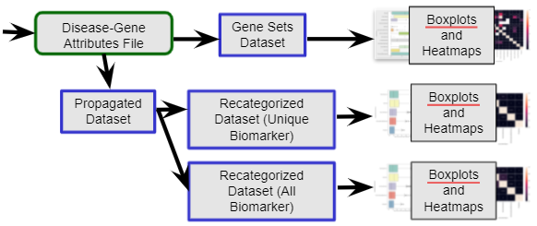
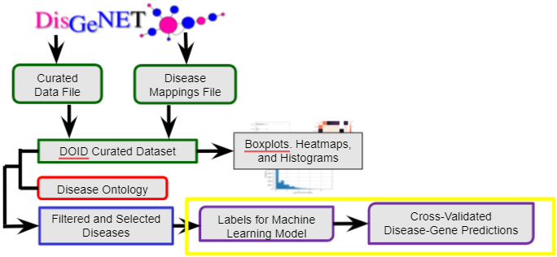

QUESTION RAISED
Can models trained on one association type predict the genes associated to another association type?
Notes:
We could now apply a supervised machine learning approach on 77 manually chosen diseases from the filtered dataset to determine if, for any given disease, models trained on one source can predict genes associated to another source.
All of the selected labels would be split into 3 folds and each of the 77 diseases would be trained on its sources it has labels for. We would then unsplit the folds and evaluate on another source that disease has information/label for.
After the evaluation process, files listing numerous model performance metrics are created and amended into a single dataset.
Results can then be analyzed through plots such as heatmaps.

Slide 14
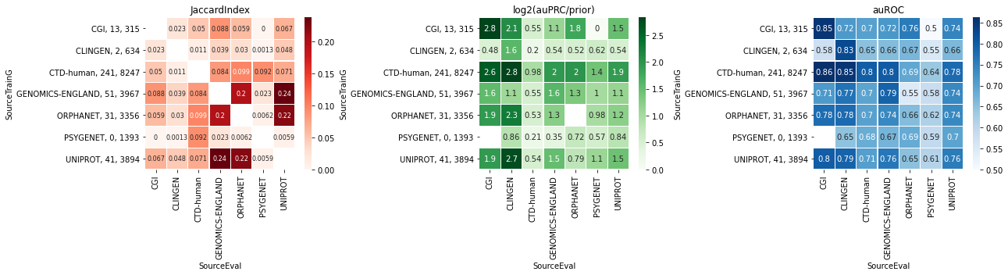
Heatmaps of Median Jaccard Index, Median log2(auPRC/prior) Score, and Median auROC Score for All Sources
Notes:
This visualization came in the form of three heatmaps, the first comparing the median correlation of gene sets between sources as we did prior, the second showing the median log2(auPRC/prior), which tells us how much better our model did than random performance, and a third showing the median auROC, which tells us the probability that, if we select one positive and one negative from our data, our model will rank the positive higher than the negative. These results will need to be examined in detail later, but we can see that certain sources do a better job at predicting genes associated to another source.

Slide 15
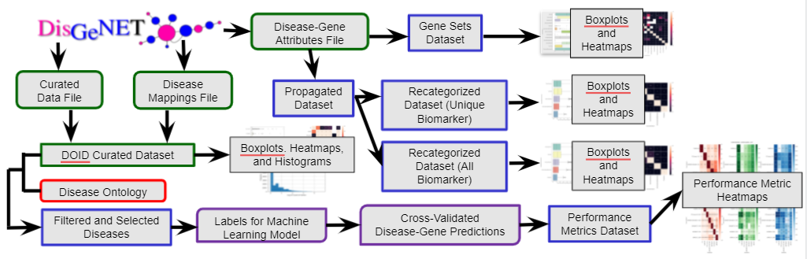
CONCLUSION
We tried to answer:
Do different experimental methods provide the same view of the underlying biology, or do they present different aspects of it?
Can models trained on one experimental method predict the genes associated to another?
Notes:
Overall, we determined some sources and association types demonstrate little correlation to others, represented by their low jaccard index values. However, a few provide similar views of the underlying biology. Furthermore, based on the high-performance metrics for certain sources trained or evaluated on, models trained on one experimental method can predict genes associated to another.

Slide 16
FUTURE WORK
Create an ensemble model
Make my work available for further disease study
Notes:
After reviewing the metrics of the selected diseases further, we plan to combine the machine learning models from the distinct sources into an ensemble model that discovers novel genes across the human genome associated with the disease. I will also make my work readily available to members of the Krishnan laboratory to allow the results to be incorporated into further disease study.

Slide 17
ACKNOWLEDGEMENTS
Anna Yannakopoulos
Dr. Arjun Krishnan
Jaewook Lee
REU Staff (Laura Harris, Brian O’Shea)
Notes:
Anna Yannakopoulos:
Has helped me with every step of the process
Has been amazing in offering advice and answering my questions
Arjun:
Has been extremely helpful with overarching goals for the project and leading me in the best direction
Jaewook Lee:
Has been a great partner throughout the project
REU Staff (Laura Harris, Brian O’Shea)

Slide 18
REFERENCES
https://www.disgenet.org/home/
Pictures:
https://www.google.com/url?sa=i&url=https%3A%2F%2Fgeneticliteracyproject.org%2F2017%2F02%2F28%2Fcell-atlas-37-trillion-cells-in-the-human-body-will-be-catalogued-in-ambitious-effort%2F&psig=AOvVaw3apfkgoRHYM1CKVpu0_Mjz&ust=1624486232801000&source=images&cd=vfe&ved=0CAoQjRxqFwoTCLDTmO77rvECFQAAAAAdAAAAABAD
https://www.google.com/url?sa=i&url=https%3A%2F%2Fhub.jhu.edu%2F2017%2F07%2F05%2Flasso-probe-clones-thousands-genes-at-once%2F&psig=AOvVaw1tiKrxbRUWx-2R9St5k5Ka&ust=1624579437360000&source=images&cd=vfe&ved=0CAoQjRxqFwoTCICEh5r8rvECFQAAAAAdAAAAABAD
https://www.google.com/url?sa=i&url=https%3A%2F%2Fwww.nature.com%2Farticles%2Fd41586-019-03536-x&psig=AOvVaw0_kgJMWiXzUfn0ebt6G7Hg&ust=1624484880954000&source=images&cd=vfe&ved=0CAoQjRxqFwoTCLCsr_mbrPECFQAAAAAdAAAAABAQ
https://www.google.com/url?sa=i&url=https%3A%2F%2Fwww.aiche.org%2Fchenected%2F2020%2F05%2Fbioengineering-translational-medicine-addresses-formulation-and-delivery-strategies-covid-19-drugs&psig=AOvVaw1Lc853h-Fal62sLL2QDJxZ&ust=1624592303998000&source=images&cd=vfe&ved=0CAoQjRxqFwoTCLiZzIysr_ECFQAAAAAdAAAAABAD

